Slide 1


System Analysis And Design (SAD)
Smita Bisht
Assistant Professor
School of Polytechnic

Slide 2
PRELIMINARY INVESTIGATIONS
Preliminary investigation is the first phase, In this phase, the system is investigated. The objective of this phase is to conduct an initial analysis and findings of the system.
In preliminary investigation process, group of people study the existing system and need for new system. These study are then documented and presented as report .

Slide 3
STAGES OF PRELIMINARY INVESTIGATION
1) System Identification.
2) Determine the Project Size.
3) Determine costs and benefits.
4) Alternate Solutions.

Slide 4
(1) SYSTEM IDENTIFICATION
This phase is used to recognize the need for a new system.
It is very important step. The system is identified at this stage.
To clarify the request of the projects,
Everything performed in future depends on this definition and identification.

Slide 5
What we are going to do and what is required?
What is the reason of the request of the requestor?
Is there any different requirement from what the users are requesting?
What is the real problem in the existing system that needs to be handled??
The goal is to reach the real problem of the system.

Slide 6
(2) DETERMINE THE PROJECT SIZE
The analyst must determine the exact size of the project they are going to develop.
Cases
The new Project has The new Project has been
been created as a created from scratch.
modification to
existing system.

Slide 7
(3) DETERMINE THE COST AND BENEFITS
Analyzing the data for finding out estimated cost and time for development of project.
The analyst checks the projects usability for the end users.
Analyst uses many techniques to produce the precise estimate.

Slide 8
(4) ALTERNATE SOLUTIONS
A system may be developed by many ways. This step identifies all possible ways to develop a system.
It is used to select the best solution that fulfills the requirements.

Slide 9
INFORMATION GATHERING
Data/Information gathering techniques are used to collect detailed information about system. Information Gathering methods are:
      Review the documents.
      On-site Observation.
      Interviews.
      Questionnaires.

Slide 10
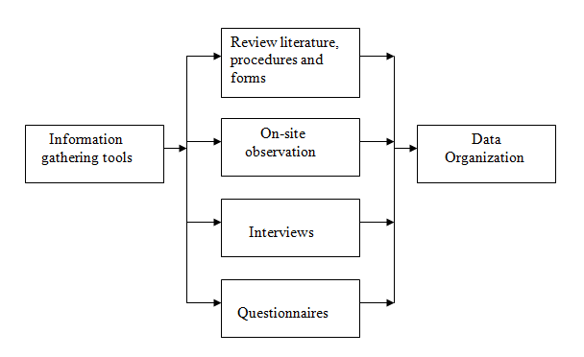

Slide 11
(1) REVIEW THE DOCUMENTS
Reviewing the current process and documentation can help the analyst understand the business, or system, and its current situation.
They were quite effective in guiding us towards visualizing the features that were needed to be put together in the system and the required output which had to be generated once the system became functional.

Slide 12
A drawback to analyzing documents is that documents may be outdated, the analyst must confirm whether the documents are current or not.
Another drawback to reviewing documents is it can be very time consuming, depending on the organization and the system.
A system that interacts with many different facets of the business will have large amounts of documentation to review.

Slide 13
(2) ON-SITE OBSERVATION
Another technique utilized by us to gain information about the project was to visit the client site where the system had to be installed.
Here a detailed system study was carried out, checking the existing system to replicate it with our system. We also observed the activities of the system directly.

Slide 14
During the on-site observation, we saw the office environment, work load of the system and users, method of work, and the facilities provided by the organization. This information helped us to understand how the system should operate.

Slide 15
(3) INTERVIEW
Interviews are useful tools for gathering in-depth information from clients.
Interviews are particularly valuable because they allow us to ask follow-up questions of interviewees when we need clarification about a particular response.

Slide 16
(4) QUESTIONNAIRE
It is also very simple and quick method of collecting information
Questionnaire is a self-administered tool that is more economical and requires less skill to administer than the interview.
At any point in time, unlike the interview, feedback from many respondents can be collected at the same time.

Slide 17
BASIS FOR COMPARISON | INTERVIEW | QUESTIONNAIRE
MEANING | a form consisting of a series of written or printed multiple choice questions, to be marked by the informants. | formal conversation between the interviewer and respondent wherein the two participates in the question answer session.
FORM | Written | Oral
COST | Economical | Expensive
COMMUNICATION | One to many | One to one
ORDER OF QUESTIONS | Cannot be changed, as they are written in an appropriate sequence. | Can be changed as per need and preference.

Slide 18
PROJECT REVIEW AND SELECTION
An organisation does get a number of project proposals that need to be automated through the information system.
The organisation cannot entertain all those requests because of the budget and time constraints. So the organisation has to select those proposals only that are highly favourable to the organization.

Slide 19
Many methods are used for the same , the best among them is the steering committee method.
Steering committee consists of various area managers and analysts, all of them have an authority to select or reject any proposal.
The committee uses the information collected during preliminary investigation as a base to approve or reject a project.
As it consists of managers of various fields they can discuss all the aspects of various departments and can come to a decision.

Slide 20
PROJECT SCOPE
When it comes to project planning, defining the project scope is the most critical step.
In case if we start the project without knowing what we are supposed to be delivering at the end to the client and what the boundaries of the project are, there is a little chance of success.
The main purpose of the scope definition is to clearly describe the boundaries of the project.

Slide 21
Clearly describing the boundaries is not enough when it comes to project. You need to get the client's agreement as well.
Therefore, the defined scope of the project usually included into the contractual agreements between the client and the service provider. SOW, or in other words, Statement of Work, is one such document.

